Slide 1
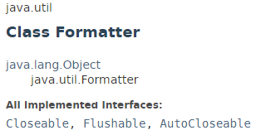
java.util.Formatter
Formatter class outputs the formatted output. It can format numbers, strings, and time and date. It operates in a manner similar to the C/C++ printf() function.

Slide 2
EnumSet
https://docs.oracle.com/javase/8/docs/api/index.html?java/util/Formatter.html

